Slide 1
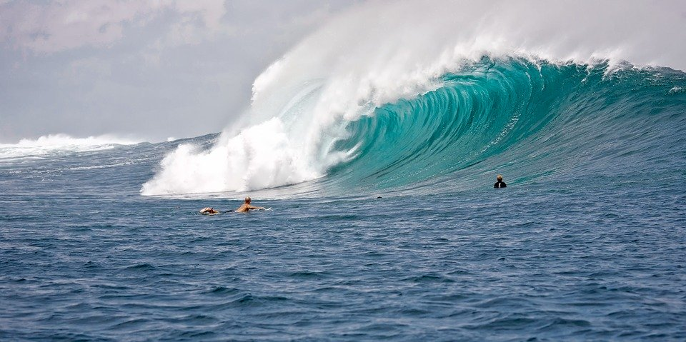

Waves
Everyday Science
With BOCES 4 Science
https://sites.google.com/wflboces.org/boces4science/home
Grade 4 Waves

Slide 2

WHAT ARE Waves?
What is the pattern of motion of all waves?

Slide 3


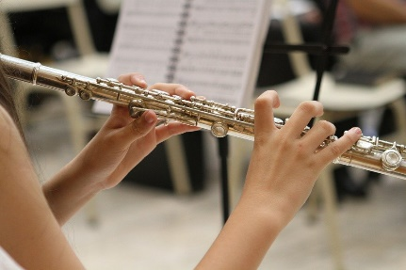
Different types of waves
Water
Light
Sound
All Waves have the same pattern of motion!

Slide 4


Your Challenge
Design an investigation to observe waves and figure out the pattern of motion all waves have.
This is an animated introduction to waves. It focuses on
ocean waves, but does a good job introducing waves.
Bill Nye Video on waves, watch the first 2:50.
Sometimes you have to search in YouTube for “Bill Nye Waves”

Slide 5
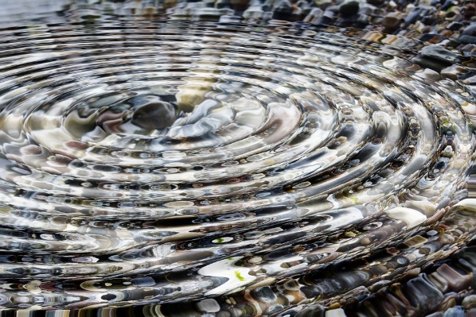
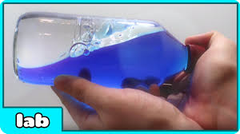
Create some waves!
Do you have a Slinky, jump rope, or any rope?
Drop a pebble, penny or marble in a bucket/pan of water.
Try making this at home.

